Slide 1
Seeing and Believing
2024 Quarter 4 Lesson 7
John 18, 19, 20

Slide 2
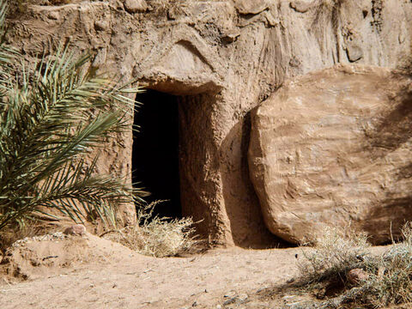
He Saw and Believed - John 20:1
The first day of the week cometh Mary Magdalene early, when it was yet dark, unto the sepulchre, and seeth the stone taken away from the sepulchre.

Slide 3
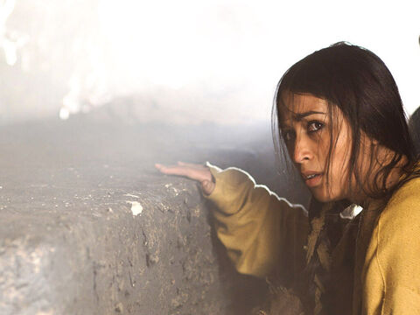
He Saw and Believed - John 20:2
Then she runneth, and cometh to Simon Peter, and to the other disciple, whom Jesus loved, and saith unto them, They have taken away the Lord out of the sepulchre, and we know not where they have laid him.

Slide 4
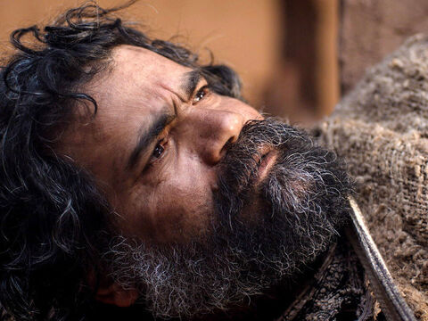
He Saw and Believed - John 20:3
Peter therefore went forth, and that other disciple, and came to the sepulchre.

Slide 5
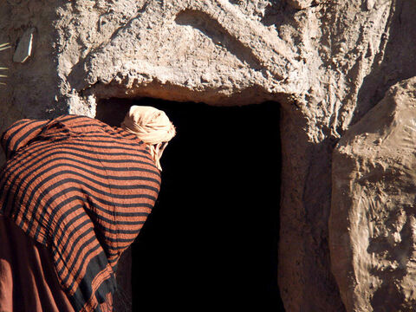
He Saw and Believed - John 20:4
So they ran both together: and the other disciple did outrun Peter, and came first to the sepulchre.

Slide 6
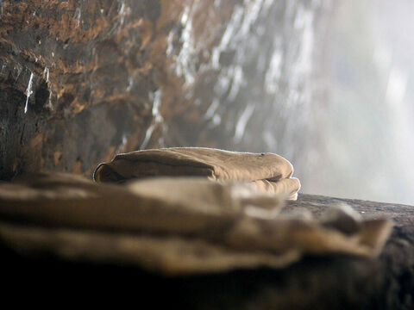
He Saw and Believed - John 20:5
And he stooping down, and looking in, saw the linen clothes lying; yet went he not in.

Slide 7
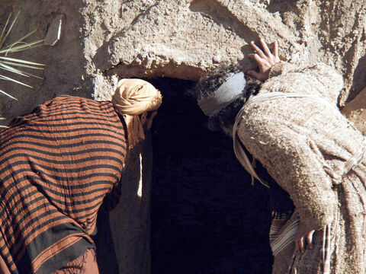
He Saw and Believed - John 20:6
Then cometh Simon Peter following him, and went into the sepulchre, and seeth the linen clothes lie,

Slide 8
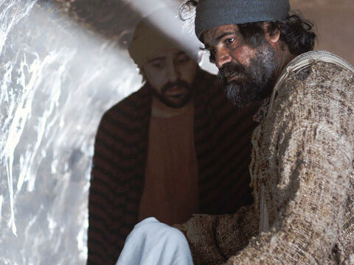
He Saw and Believed - John 20:7
And the napkin, that was about his head, not lying with the linen clothes, but wrapped together in a place by itself.

Slide 9
He Saw and Believed - John 20:8
Then went in also that other disciple, which came first to the sepulchre, and he saw, and believed.

Slide 10
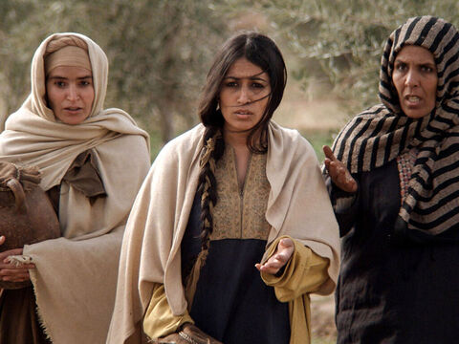
He Saw and Believed - John 20:9
For as yet they knew not the scripture, that he must rise again from the dead.

Slide 11
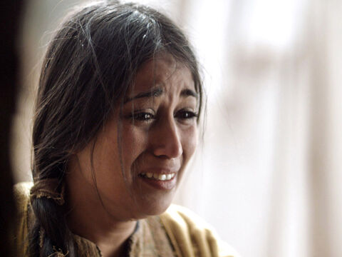
He Saw and Believed - John 20:10
Then the disciples went away again unto their own home.

Slide 12
John remembered Jesus’ prediction of His resurrection. Peter was probably more skeptical. Luke reports that Peter wondered “in himself at that which was come to pass” (ch. 24:12).
SDABC
John “saw, and believed.” He did not yet understand the scripture that Christ must rise from the dead; but he now remembered the Saviour's words foretelling His resurrection. - DA 729

Slide 13
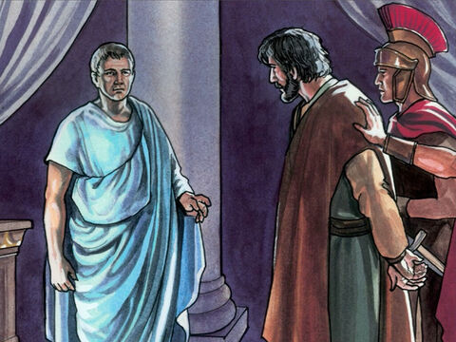
Not Seeing - John 18:33
Then Pilate entered into the judgment hall again, and called Jesus, and said unto him, Art thou the King of the Jews?

Slide 14
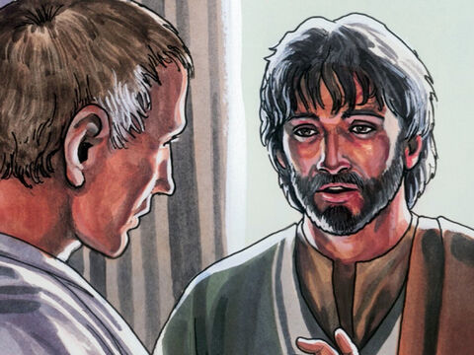
Not Seeing - John 18:34
Jesus answered him, Sayest thou this thing of thyself, or did others tell it thee of me?

Slide 15
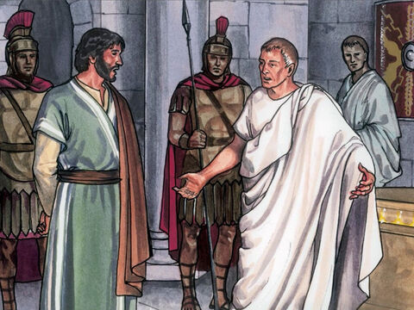
Not Seeing - John 18:35
Pilate answered, Am I a Jew? Thine own nation and the chief priests have delivered thee unto me: what hast thou done?

Slide 16
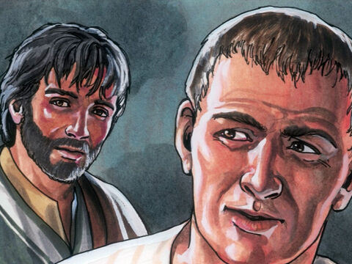
Not Seeing - John 18:36
Jesus answered, My kingdom is not of this world: if my kingdom were of this world, then would my servants fight, that I should not be delivered to the Jews: but now is my kingdom not from hence.

Slide 17
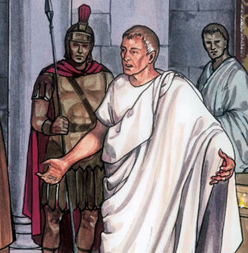
Not Seeing - John 18:37
Pilate therefore said unto him, Art thou a king then? Jesus answered, Thou sayest that I am a king. To this end was I born, and for this cause came I into the world, that I should bear witness unto the truth. Every one that is of the truth heareth my voice.

Slide 18
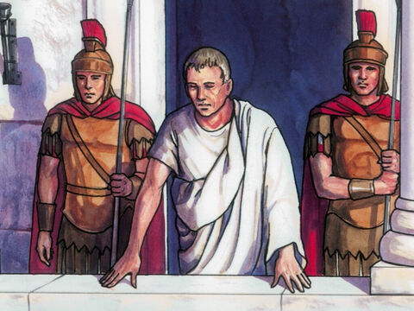
Not Seeing - John 18:38
Pilate saith unto him, What is truth? And when he had said this, he went out again unto the Jews, and saith unto them, I find in him no fault at all.

Slide 19
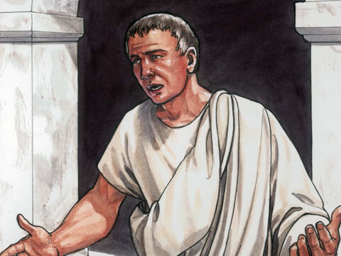
Not Seeing - John 19:4
Pilate therefore went forth again, and saith unto them, Behold, I bring him forth to you, that ye may know that I find no fault in him.

Slide 20
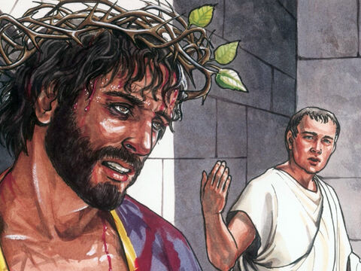
Not Seeing - John 19:5
Then came Jesus forth, wearing the crown of thorns, and the purple robe. And Pilate saith unto them, Behold the man!

Slide 21
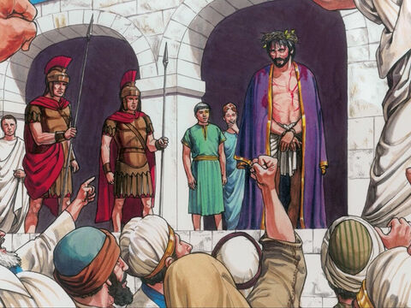
Not Seeing - John 19:6
When the chief priests therefore and officers saw him, they cried out, saying, Crucify him, crucify him. Pilate saith unto them, Take ye him, and crucify him: for I find no fault in him.

Slide 22
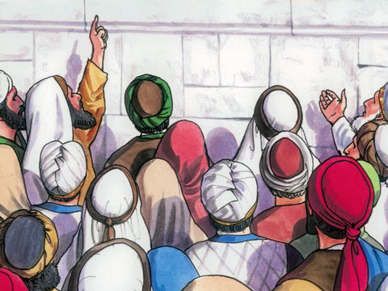
Not Seeing - John 19:7
The Jews answered him, We have a law, and by our law he ought to die, because he made himself the Son of God.

Slide 23
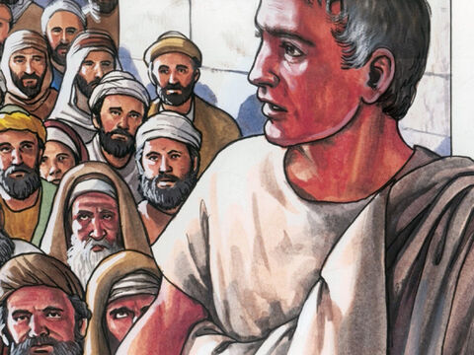
Not Seeing - John 19:8
When Pilate therefore heard that saying, he was the more afraid;

Slide 24
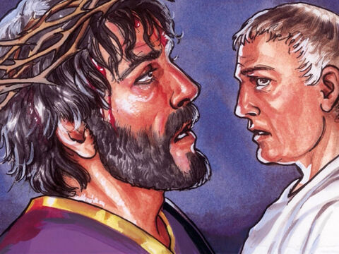
Not Seeing - John 19:9
And went again into the judgment hall, and saith unto Jesus, Whence art thou? But Jesus gave him no answer.

Slide 25
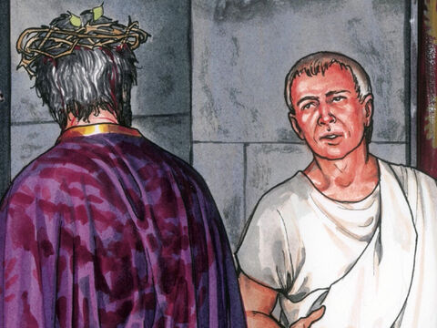
Not Seeing - John 19:10
Then saith Pilate unto him, Speakest thou not unto me? knowest thou not that I have power to crucify thee, and have power to release thee?

Slide 26
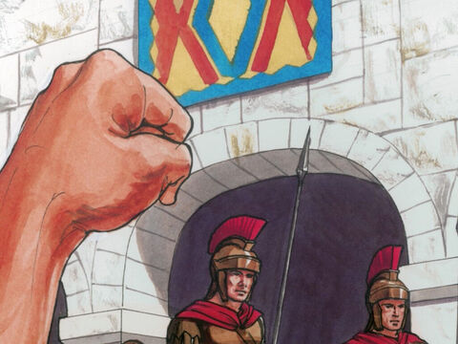
Not Seeing - John 19:11
Jesus answered, Thou couldest have no power at all against me, except it were given thee from above: therefore he that delivered me unto thee hath the greater sin.

Slide 27
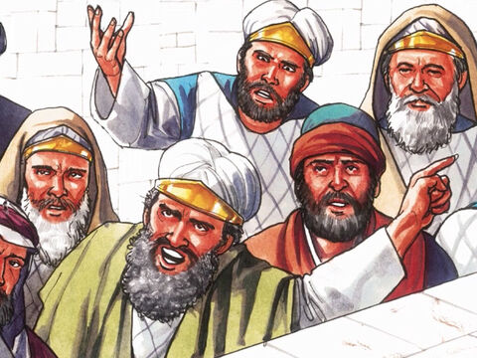
Not Seeing - John 19:12
And from thenceforth Pilate sought to release him: but the Jews cried out, saying, If thou let this man go, thou art not Caesar's friend: whosoever maketh himself a king speaketh against Caesar.

Slide 28
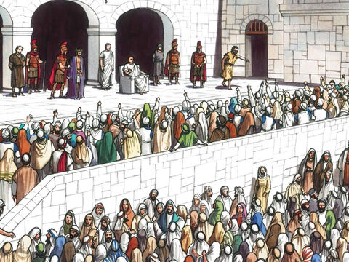
Not Seeing - John 19:13
When Pilate therefore heard that saying, he brought Jesus forth, and sat down in the judgment seat in a place that is called the Pavement, but in the Hebrew, Gabbatha.

Slide 29
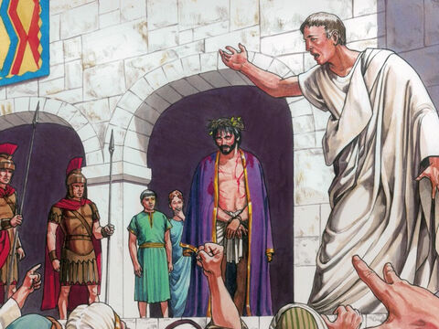
Not Seeing - John 19:14
And it was the preparation of the passover, and about the sixth hour: and he saith unto the Jews, Behold your King!

Slide 30
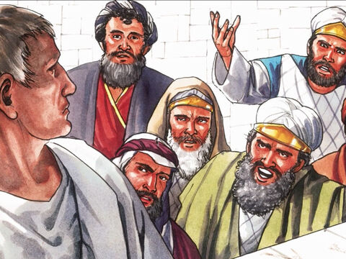
Not Seeing - John 19:15
But they cried out, Away with him, away with him, crucify him. Pilate saith unto them, Shall I crucify your King? The chief priests answered, We have no king but Caesar.

Slide 31
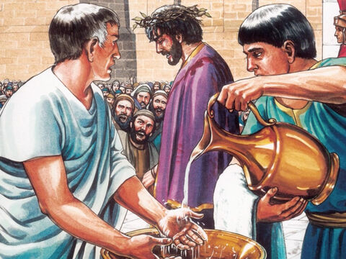
Not Seeing - John 19:16
Then delivered he him therefore unto them to be crucified. And they took Jesus, and led him away.

Slide 32
Pilate longed to deliver Jesus. But he saw that he could not do this, and yet retain his own position and honor. Rather than lose his worldly power, he chose to sacrifice an innocent life. How many, to escape loss or suffering, in like manner sacrifice principle.
Conscience and duty point one way, and self-interest points another. The current sets strongly in the wrong direction, and he who compromises with evil is swept away into the thick darkness of guilt.
The Desire of Ages pg. 738

Slide 33
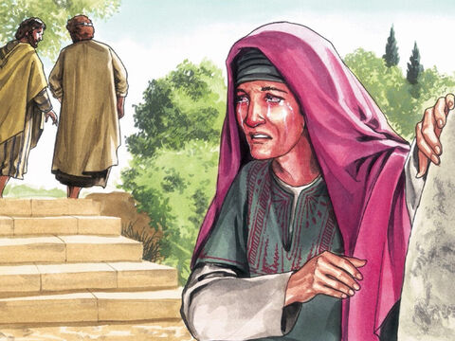
Seeing - John 20:11
But Mary stood without at the sepulchre weeping: and as she wept, she stooped down, and looked into the sepulchre,

Slide 34
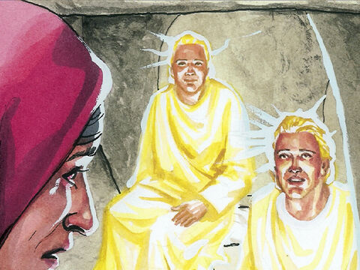
Seeing - John 20:12
And seeth two angels in white sitting, the one at the head, and the other at the feet, where the body of Jesus had lain.

Slide 35
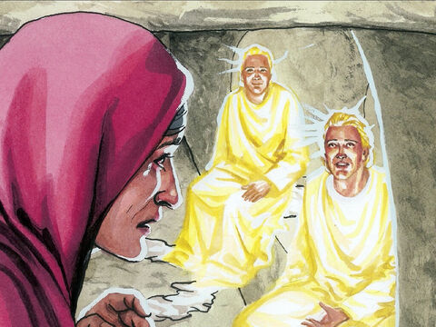
Seeing - John 20:13
And they say unto her, Woman, why weepest thou? She saith unto them, Because they have taken away my Lord, and I know not where they have laid him.

Slide 36
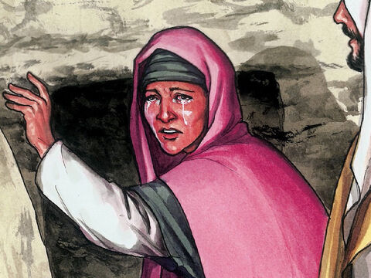
Seeing - John 20:14
And when she had thus said, she turned herself back, and saw Jesus standing, and knew not that it was Jesus.

Slide 37
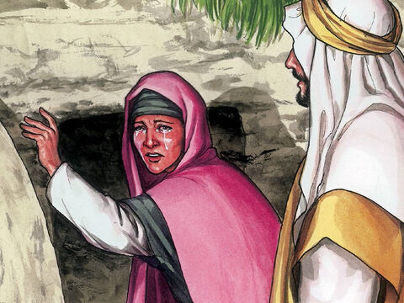
Seeing - John 20:15
Jesus saith unto her, Woman, why weepest thou? whom seekest thou? She, supposing him to be the gardener, saith unto him, Sir, if thou have borne him hence, tell me where thou hast laid him, and I will take him away.

Slide 38
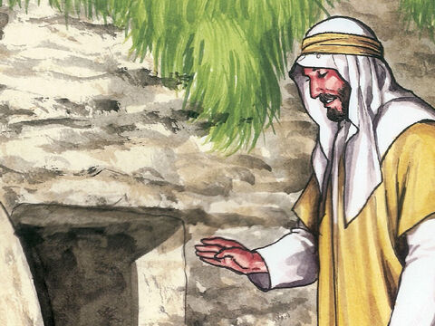
Seeing - John 20:16
Jesus saith unto her, Mary. She turned herself, and saith unto him, Rabboni; which is to say, Master.

Slide 39
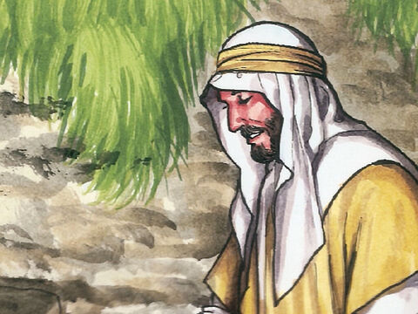
Seeing - John 20:17
Jesus saith unto her, Touch me not; for I am not yet ascended to my Father: but go to my brethren, and say unto them, I ascend unto my Father, and your Father; and to my God, and your God.

Slide 40
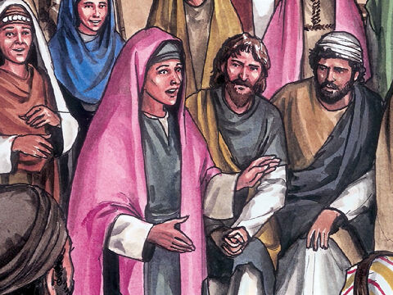
Seeing - John 20:18
Mary Magdalene came and told the disciples that she had seen the Lord, and that he had spoken these things unto her.

Slide 41
In the garden, Mary had stood weeping, when Jesus was close beside her. Her eyes were so blinded by tears that she did not discern Him. And the hearts of the disciples were so full of grief that they did not believe the angels’ message or the words of Christ Himself.
The Desire of Ages, p. 794

Slide 42

SEEING
Seeing isn’t believing… Believing is seeing!

Slide 43
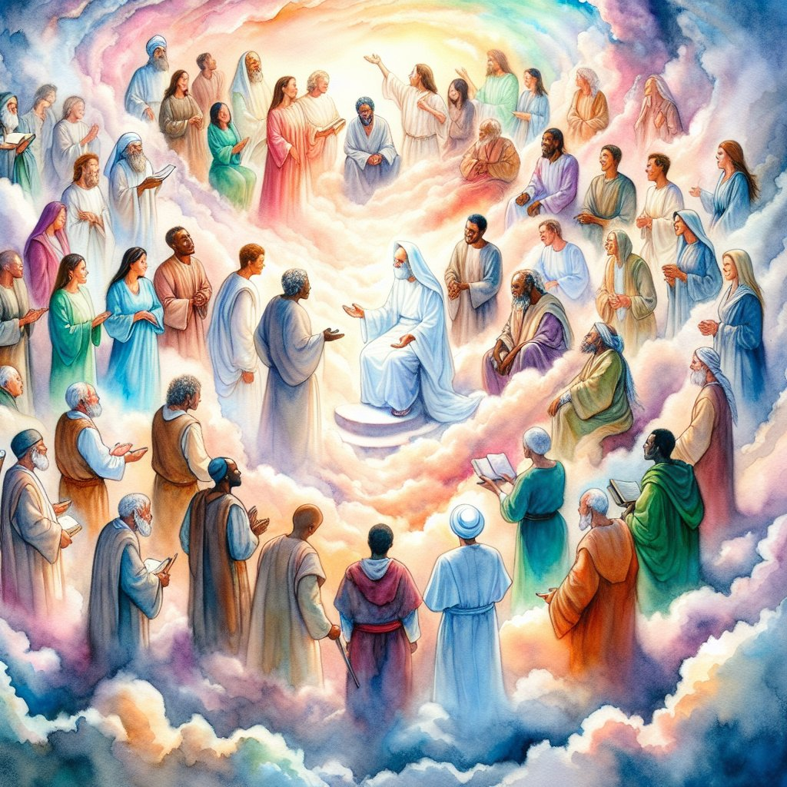
Faith - Hebrews 11:1
Now faith is the substance of things hoped for, the evidence of things not seen.

Slide 44
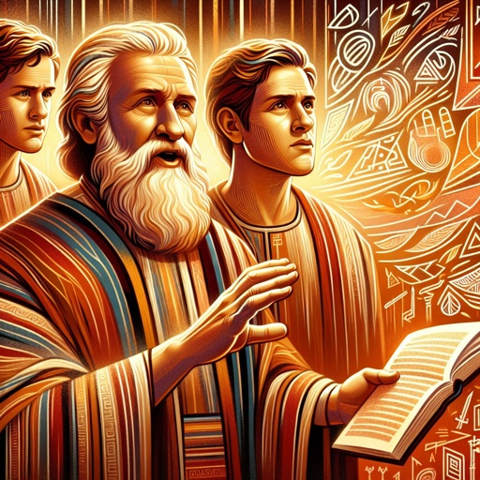
Faith - Galatians 3:8
And the scripture, foreseeing that God would justify the heathen through faith, preached before the gospel unto Abraham, saying, In thee shall all nations be blessed.

Slide 45
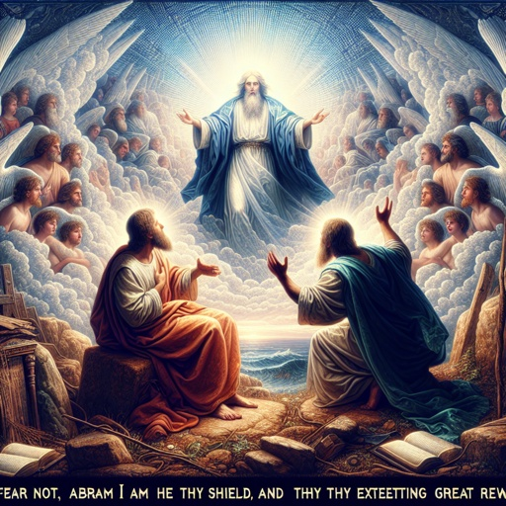
Faith - Genesis 15:1
After these things the word of the LORD came unto Abram in a vision, saying, Fear not, Abram: I am thy shield, and thy exceeding great reward.

Slide 46
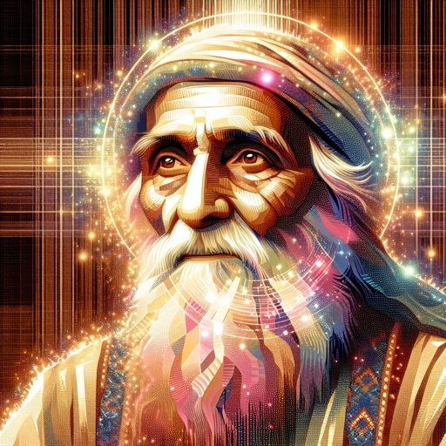
Faith - Genesis 15:2
And Abram said, Lord GOD, what wilt thou give me, seeing I go childless, and the steward of my house is this Eliezer of Damascus?

Slide 47
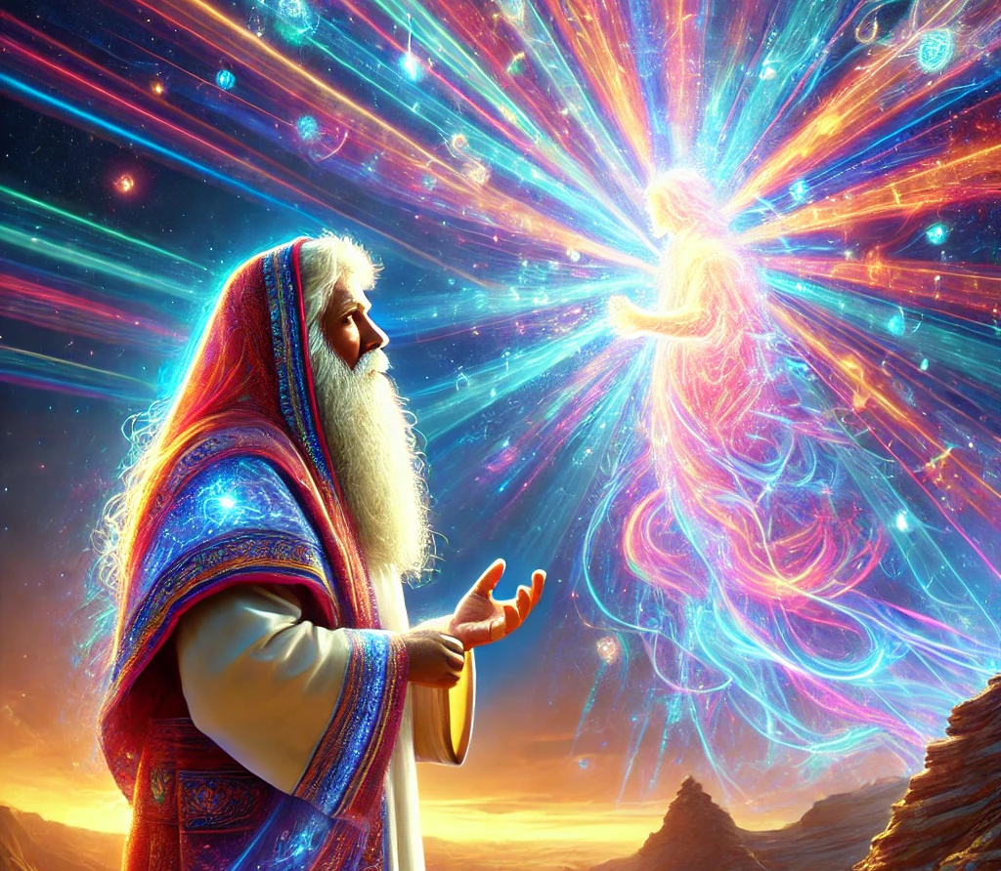
Faith - Genesis 15:3
And Abram said, Behold, to me thou hast given no seed: and, lo, one born in my house is mine heir.

Slide 48
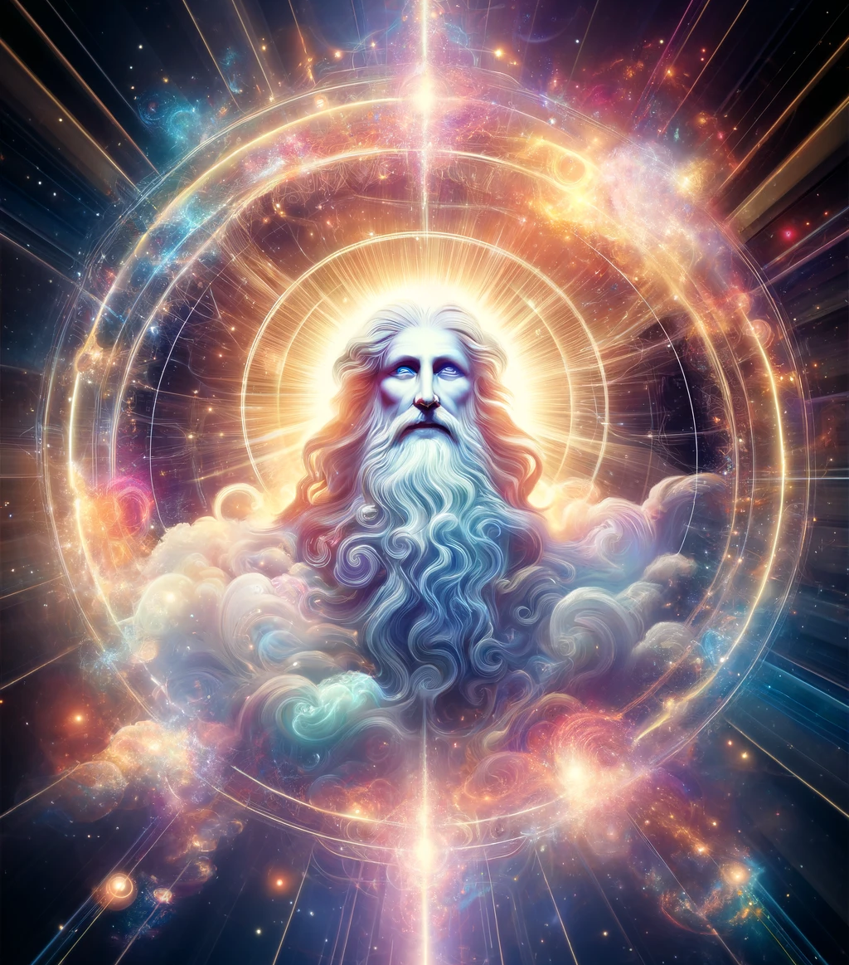
Faith - Genesis 15:4
And, behold, the word of the LORD came unto him, saying, This shall not be thine heir; but he that shall come forth out of thine own bowels shall be thine heir.

Slide 49
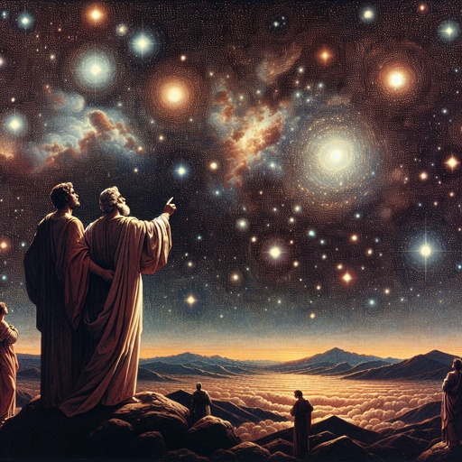
Faith - Genesis 15:5
And he brought him forth abroad, and said, Look now toward heaven, and tell the stars, if thou be able to number them: and he said unto him, So shall thy seed be.

Slide 50
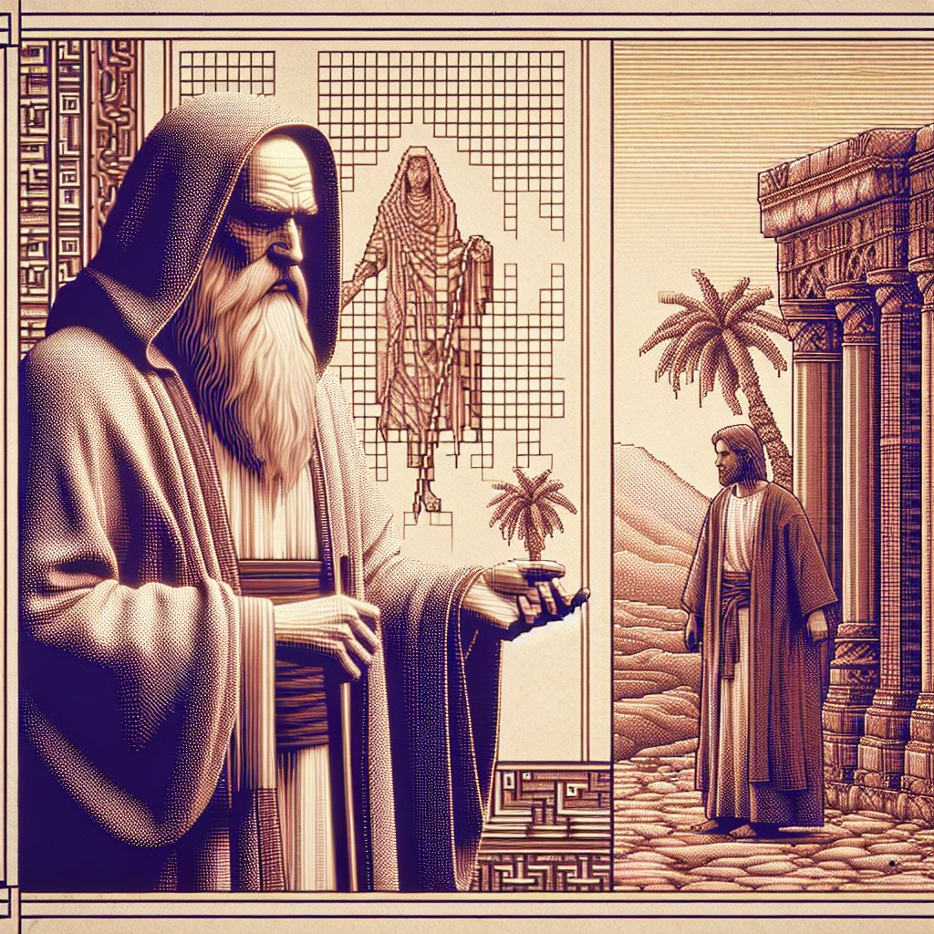
Faith - Genesis 15:6
And he believed in the LORD; and he counted it to him for righteousness.

Slide 51
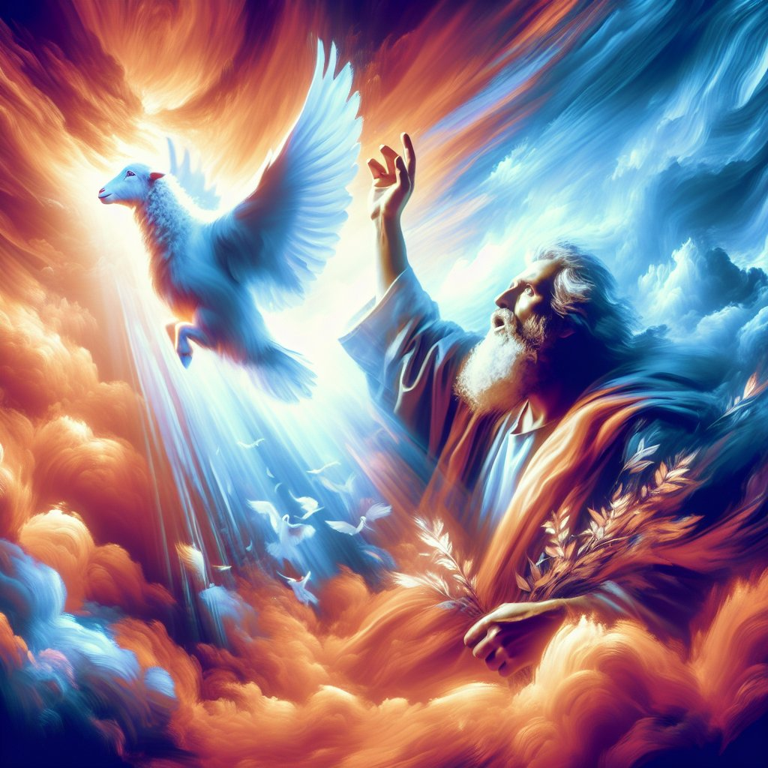
Faith - John 8:56
Your father Abraham rejoiced to see my day: and he saw it, and was glad.

Slide 52
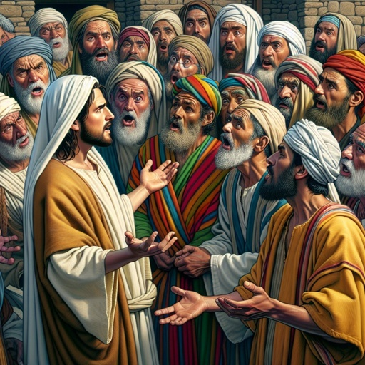
Faith - John 8:57
Then said the Jews unto him, Thou art not yet fifty years old, and hast thou seen Abraham?

Slide 53
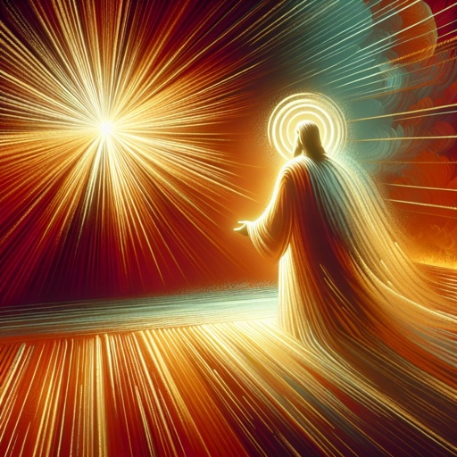
Faith - John 8:58
Jesus said unto them, Verily, verily, I say unto you, Before Abraham was, I am.

Slide 54
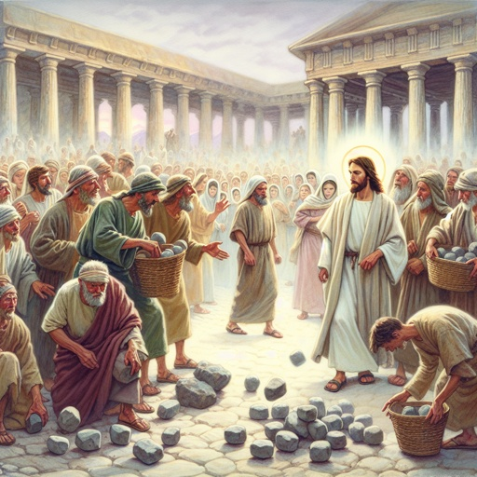
Faith - John 8:59
Then took they up stones to cast at him: but Jesus hid himself, and went out of the temple, going through the midst of them, and so passed by.

Slide 55
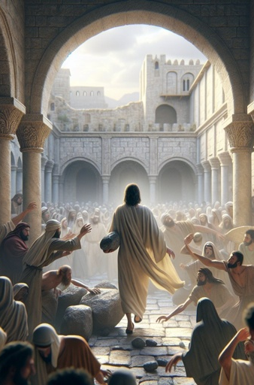
FAITH
Abraham saw by faith what these people could not even see with their eyes. We, too, are called to see beyond what our eyes can behold and live by an unseen truth.

Slide 56
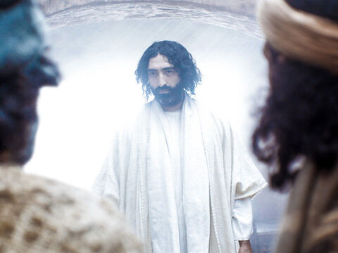
Not Believing - John 20:19
Then the same day at evening, being the first day of the week, when the doors were shut where the disciples were assembled for fear of the Jews, came Jesus and stood in the midst, and saith unto them, Peace be unto you.

Slide 57

Not Believing - John 20:20
And when he had so said, he shewed unto them his hands and his side. Then were the disciples glad, when they saw the Lord.

Slide 58

Not Believing - John 20:21
Then said Jesus to them again, Peace be unto you: as my Father hath sent me, even so send I you.

Slide 59

Not Believing - John 20:22
And when he had said this, he breathed on them, and saith unto them, Receive ye the Holy Ghost:

Slide 60
Not Believing - John 20:23
Whose soever sins ye remit, they are remitted unto them; and whose soever sins ye retain, they are retained.

Slide 61

Not Believing - John 20:24
But Thomas, one of the twelve, called Didymus, was not with them when Jesus came.

Slide 62

Not Believing - John 20:25
The other disciples therefore said unto him, We have seen the Lord. But he said unto them, Except I shall see in his hands the print of the nails, and put my finger into the print of the nails, and thrust my hand into his side, I will not believe.

Slide 63

Not Believing - John 20:26
And after eight days again his disciples were within, and Thomas with them: then came Jesus, the doors being shut, and stood in the midst, and said, Peace be unto you.

Slide 64

Not Believing - John 20:27
Then saith he to Thomas, Reach hither thy finger, and behold my hands; and reach hither thy hand, and thrust it into my side: and be not faithless, but believing.

Slide 65

Not Believing - John 20:28
And Thomas answered and said unto him, My Lord and my God.

Slide 66

Not Believing - John 20:29
Jesus saith unto him, Thomas, because thou hast seen me, thou hast believed: blessed are they that have not seen, and yet have believed.

Slide 67

Not Believing - John 20:30
And many other signs truly did Jesus in the presence of his disciples, which are not written in this book:

Slide 68

Not Believing - John 20:31
But these are written, that ye might believe that Jesus is the Christ, the Son of God; and that believing ye might have life through his name.

Slide 69
God never asks us to believe, without giving sufficient evidence upon which to base our faith. His existence, His character, the truthfulness of His word, are all established by testimony that appeals to our reason; and this testimony is abundant.
Steps to Christ p. 105

Slide 70
Yet God has never removed the possibility of doubt. Our faith must rest upon evidence, not demonstration.
Steps to Christ p.105

Slide 71
Those who wish to doubt will have opportunity; while those who really desire to know the truth will find plenty of evidence on which to rest their faith.
Steps to Christ p.105

